Slide 1

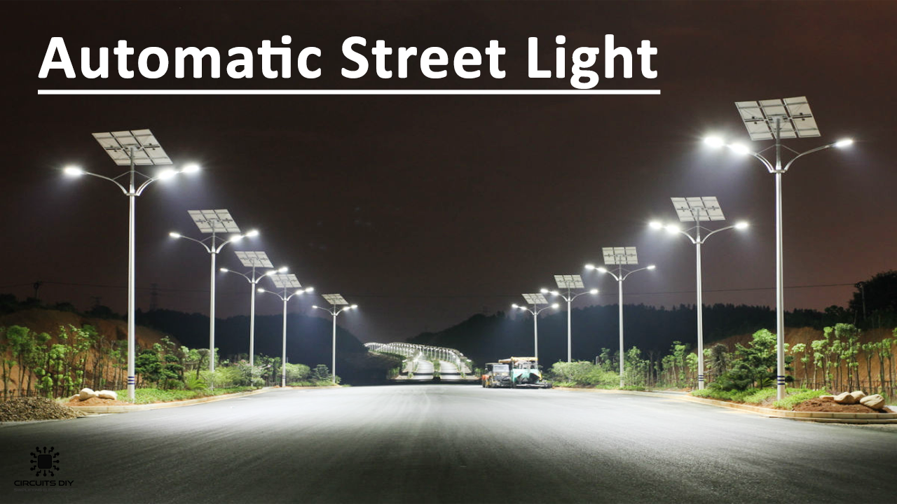
MALLABHUM INSTITUTE OF TECHNOLOGY
Project Report On
Automatic Street Light Control System
PRESENTED BY
DIBYENDU BARMAN

Slide 2
CONTENTS
INTRODUCTION
HOW IT WORKS
MAIN COMPONENTS
ABOUT THE COMPONENT
CIRCUIT OF AUTOMATIC STREET LIGHT
ADVANTAGES
DISADVANTAGES
APPLICATION
CONCLUSION
REFERENCE

Slide 3
INTRODUCTION
Reducing the wastage of power
LDR is very useful in light/dark sensor
circuit normally the resistance of an LDR is very high something as high as 100000 ohms.

Slide 4
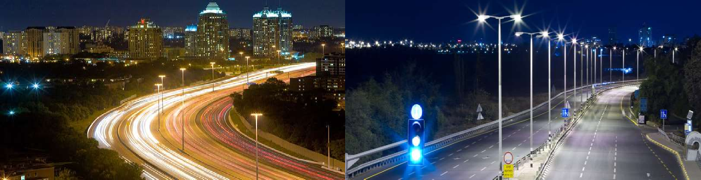
HOW IT WORKS
Light falls on LDR, it shows its minimum resistance voltage drops across LDR less than voltage of transistor, so no current will go from the collector to the emitter and transistor remains off.
It automatically switches ON lights when the sunlight goes below the visible region of our eyes. (in evening after Sunset)

Slide 5
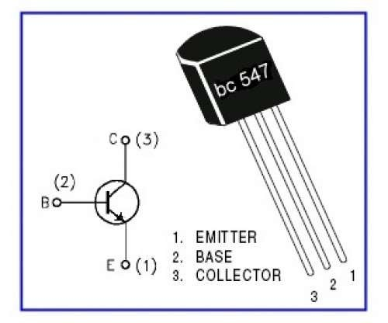
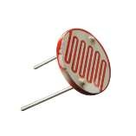
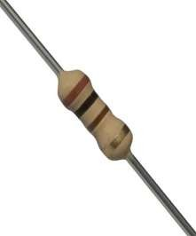
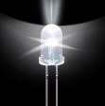
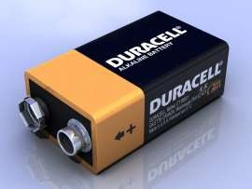
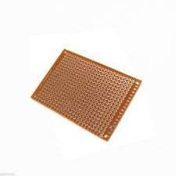
MAIN COMPONENTS
TRANSISTOR BC547
LDR (LIGHT DEPENDENCE RESISTOR)
RESISTOR
LED
BATTERY
PCB BOARD

Slide 6
THE COMPONENTS
TRANSISTOR BC547ABOUT
Has an emitter terminal, a base terminal and a collector terminal
current flowing from the base to the emitter controls the collector current

Slide 7
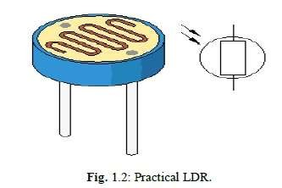
ABOUT THE COMPONENTS
LDR (LIGHT DEPENDENCE RESISTOR)
An electronic component whose resistance decreases with increasing incident light intensity
Used in a potential divider setup with a second regular resistor
RESISTOR
The flow of current across the resistor device adjustable resistors are refers to as potentiometers

Slide 8
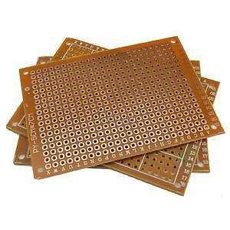
ABOUT THE COMPONENTS
BATTERY
A battery is a device that is able to store electrical energy in the
PCB BOARD(PRINTED CIRCUIT BOARD)
Mechanically supports and electrically electronic connects components using conductive tracks

Slide 9
CIRCUIT OF AUTOMATIC STREET
LIGHT

Slide 10
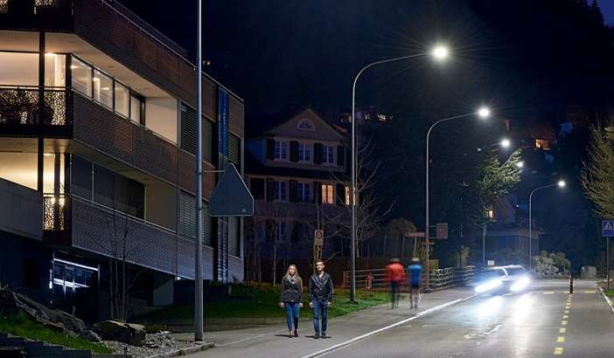
ADVANTAGES
Energy savings
Low cost
Safety and Security
Automated operation

Slide 11
DISADVANTAGES
It has a limitation of power
Light turns on when shadow falls on LDR
LED is a low voltage device

Slide 12
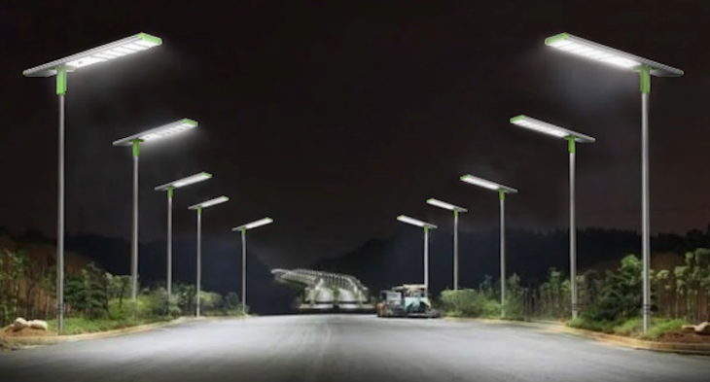
APPLICATION
Used in street light applications
Used in Domestic application

Slide 13
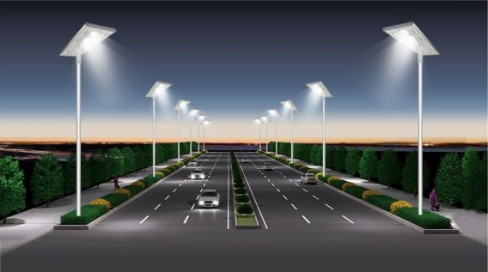
CONCLUSION
In coming days, this will prove a great boon to the country, since it will save
lot of electricity of power plant that gets wasted in illuminating the street lights.
As a conclusion, around 77%-81% of power consumption can be reduced By using this system towards providing a solution for energy saving

Slide 14
REFERENCE
Badri Narayan Sahoo, Dept. of Electronics & Communication Engineering, Siksha O Anusandhan Deemed to be University, Odisha, India. (Email: badrinarayansahu@soa.ac.in)
2. Jeeban Jyoti Mahakud, Dept. of Electronics & Communication Engineering, Siksha O Anusandhan Deemed to be University, Odisha, India. (Email: jeevanmahakud@soa.ac.in)
Priyabrata Pattanaik, Dept. of Electronics & Communication Engineering, Siksha O Anusandhan Deemed to be University, Odisha, India.
(Email: priyabratapattanaik@soa.ac.in)

Slide 15
Thank You

